Slide 1
EMPLOYEE DATASET USING EXCEL .
NAME : M. HEMALATHA .
REGISTER NO : 122201003 .
DEPARTMENT : B.COM CORPORATE SECRETARYSHIP .
COLLEGE : NAZARETH COLLEGE OF ARTS AND SCIENCE .

Slide 2
PROJECT TITLE
DATA ANAYTICS USING EXCEL.
EMPLOYEE DATASET USING EXCEL .

Slide 3

AGENDA
Introduction .
Employee Dataset Design .
Data Analysis and Visualization .
Data-Driven Insights .
Benefits and Impact .
Implementation and Maintenance .
Conclusion

Slide 4

INTRODUCTION .
"Effective employee data management is crucial for informed decision-making and strategic planning in organizations."-
"This project aims to create a comprehensive employee dataset using Excel to improve data analysis and visualization."

Slide 5
Employee Dataset And Design .
The employee dataset will comprise [list specific fields, e.g., employee ID, name, department, job title, hire date, salary, performance ratings].
Data validation and cleaning processes will ensure accuracy and consistency throughout the dataset.

Slide 6
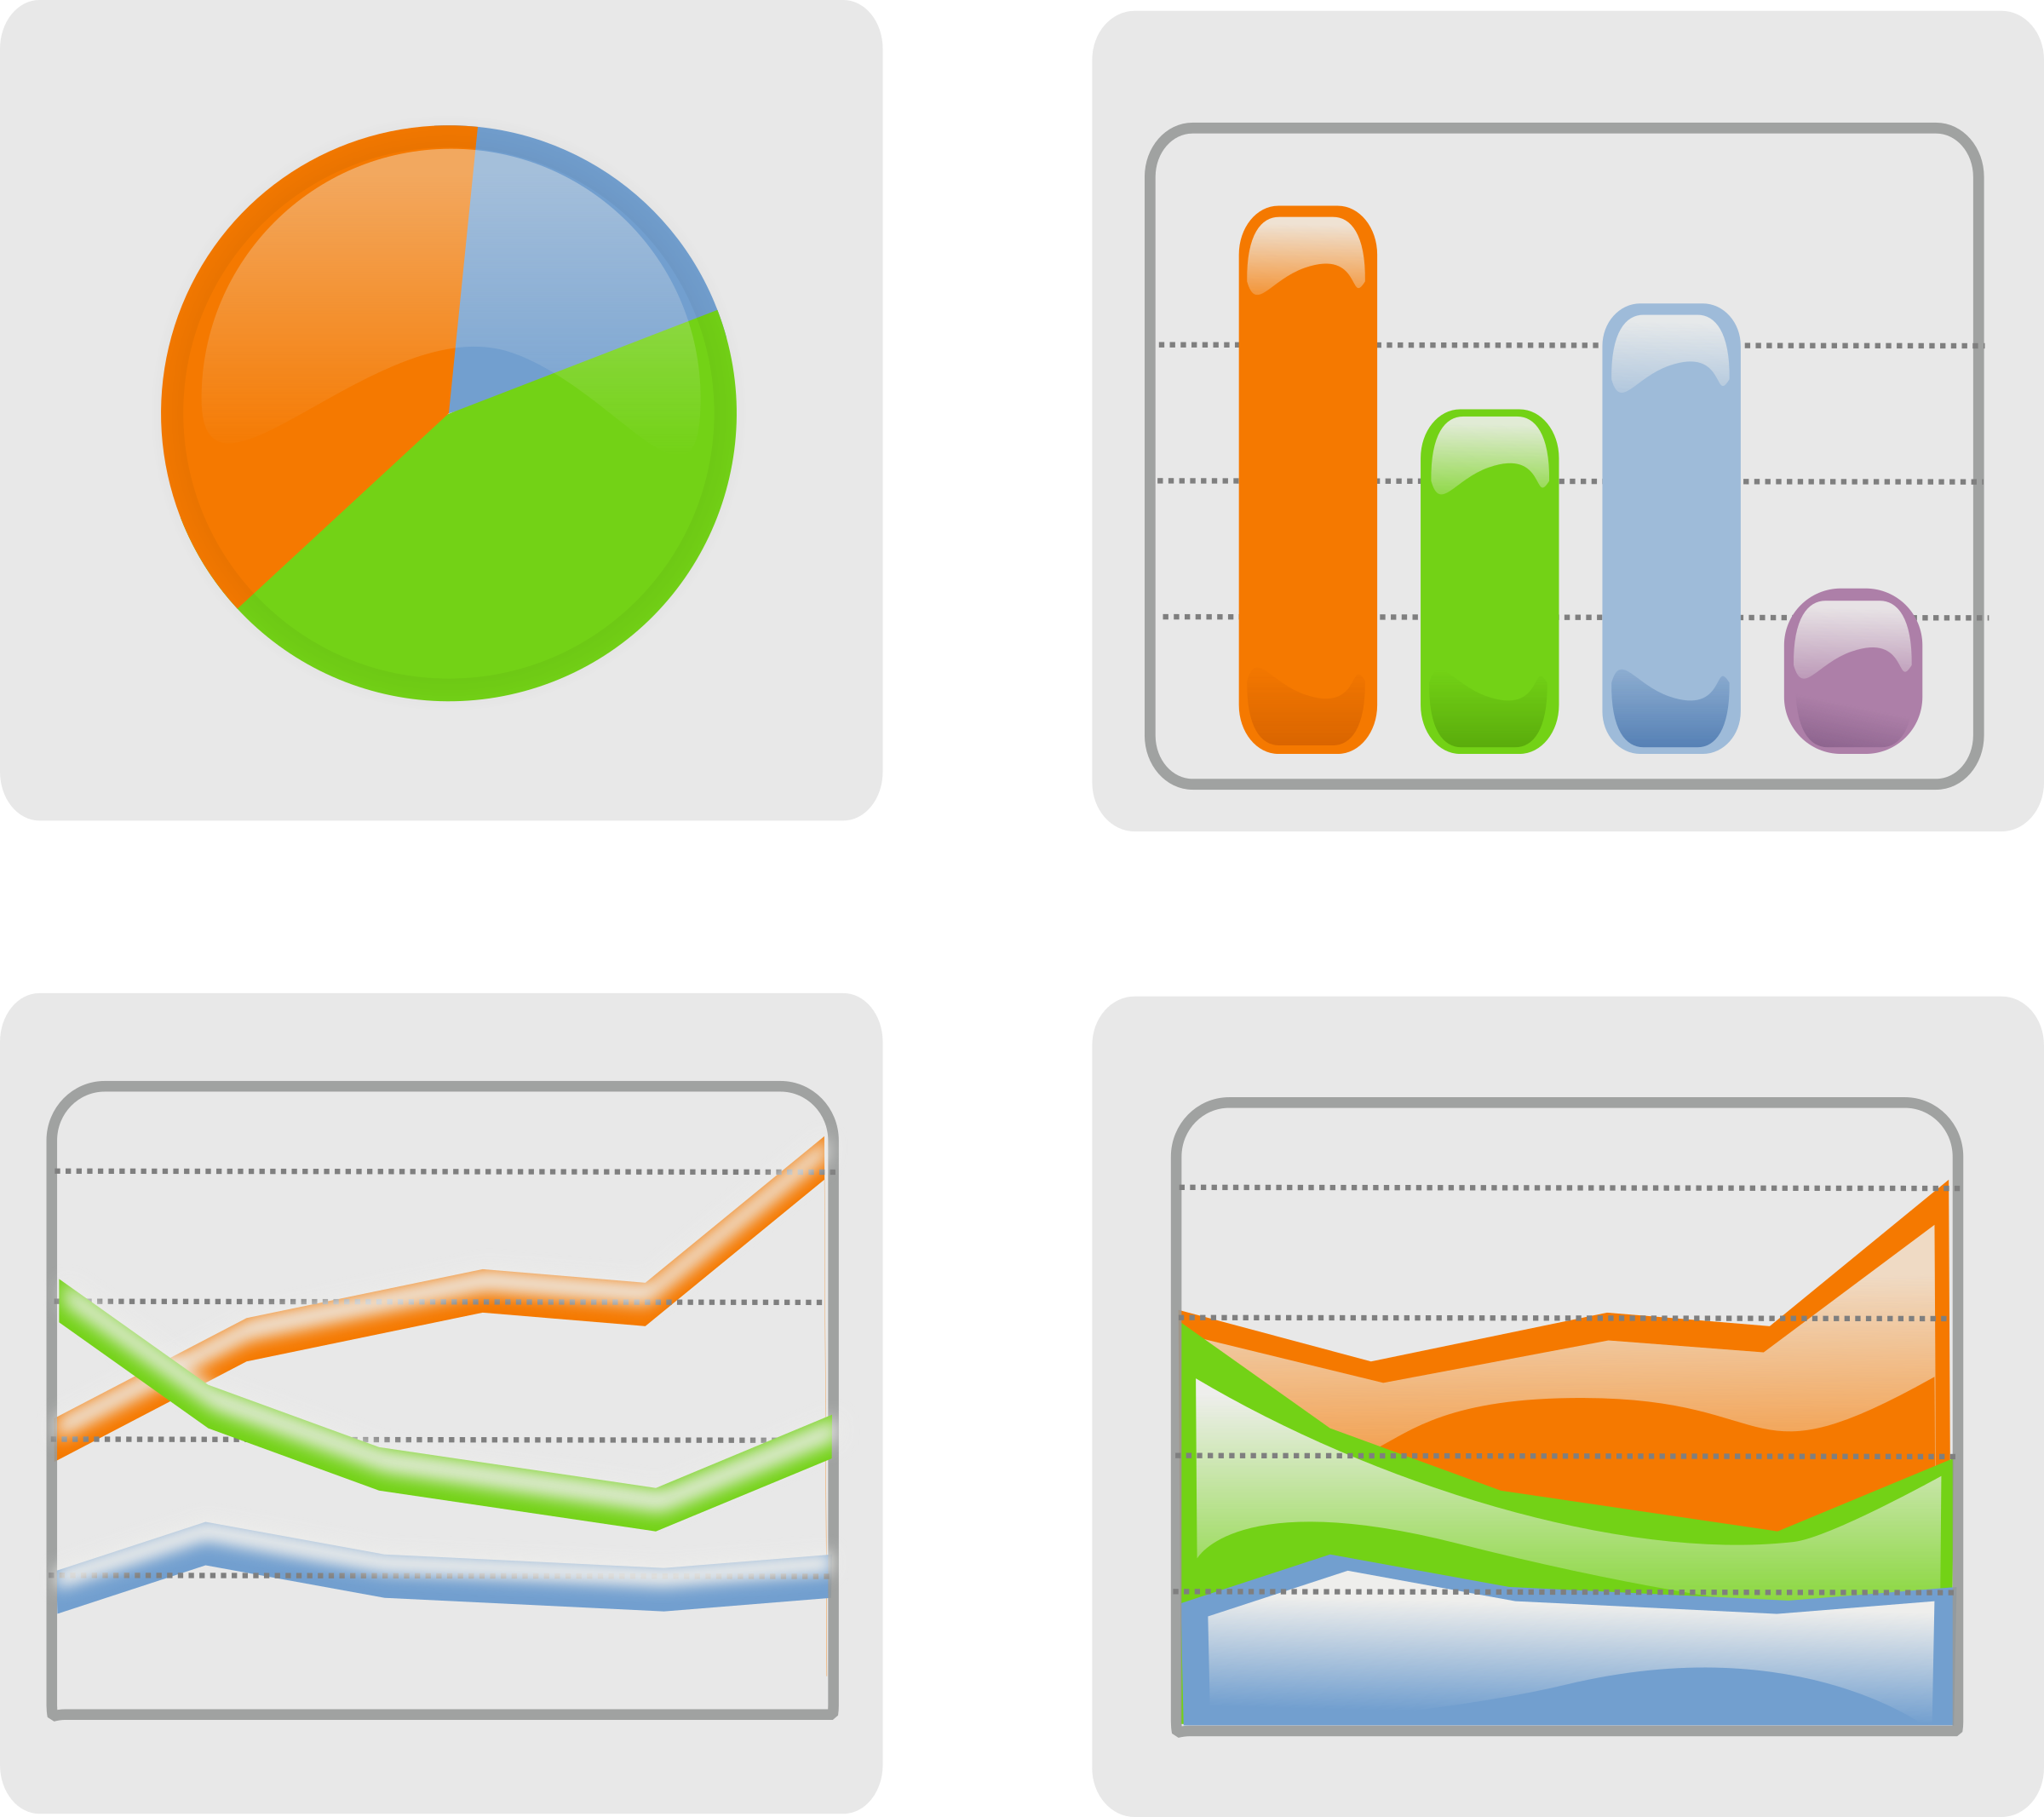
Data Analysis And Visualization .
Pivot tables and charts will be used to summarize and visualize key trends and insights from the employee data
Analysis will focus on [specific areas, e.g., employee turnover, performance ratings, departmental trends].

Slide 7

Data – Driven Insights .
The dataset reveals [key findings, e.g., high-performing departments, areas for improvement in employee performance].
Insights from the data will inform HR and management decisions, enhancing organizational effectiveness.

Slide 8
Benefits And Impacts .
The employee dataset using Excel will improve data accuracy, reduce errors, and increase efficiency in employee data management.
Data-driven insights will enable proactive decision-making, driving business growth and productivity.

Slide 9

Implementation and Maintenance .
Regular data updates and refreshes will ensure the dataset remains current and relevant.
User access and security measures will be implemented to protect sensitive employee data.

Slide 10

Conclusion .
The employee dataset using Excel project demonstrates the power of data-driven decision-making in HR and management.
Future developments will focus on expanding the dataset and integrating additional data. Feel free to modify these sentences to fit your specific needs and project goals!

